Slide 1
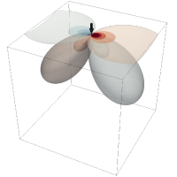

Meeting July 29, 2024
Forward and inverse modeling of wave propagation combining classical and machine learning approaches
Student: Oscar Andrés Rincón Cardeño
Advisors: Nicolas Guarín Zapata and Silvana Montoya
Applied Mechanics Research Group
Universidad EAFIT

Slide 2
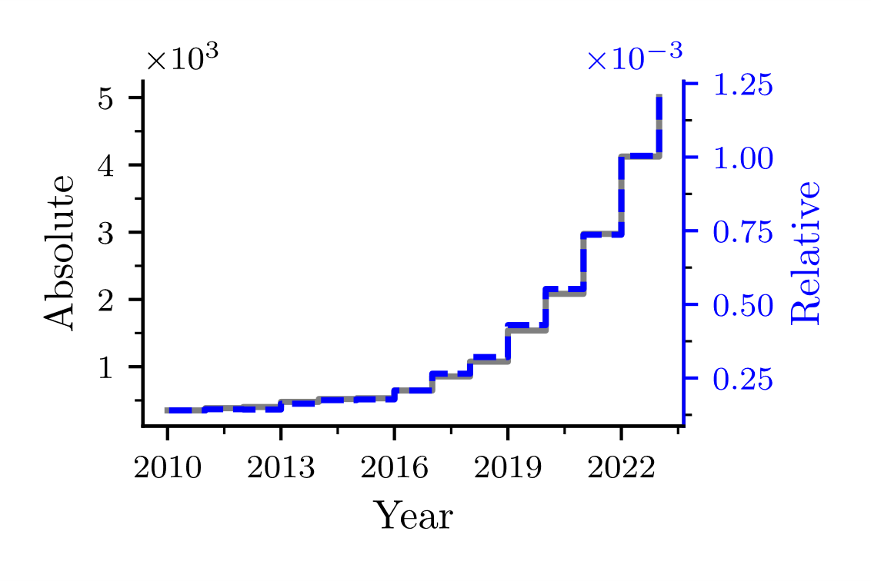
Introduction
"machine learning" OR "deep learning" OR "neural networks" AND "wave propagation" OR "wave equation" AND (modeling OR modelling OR model OR simulation)

Slide 3
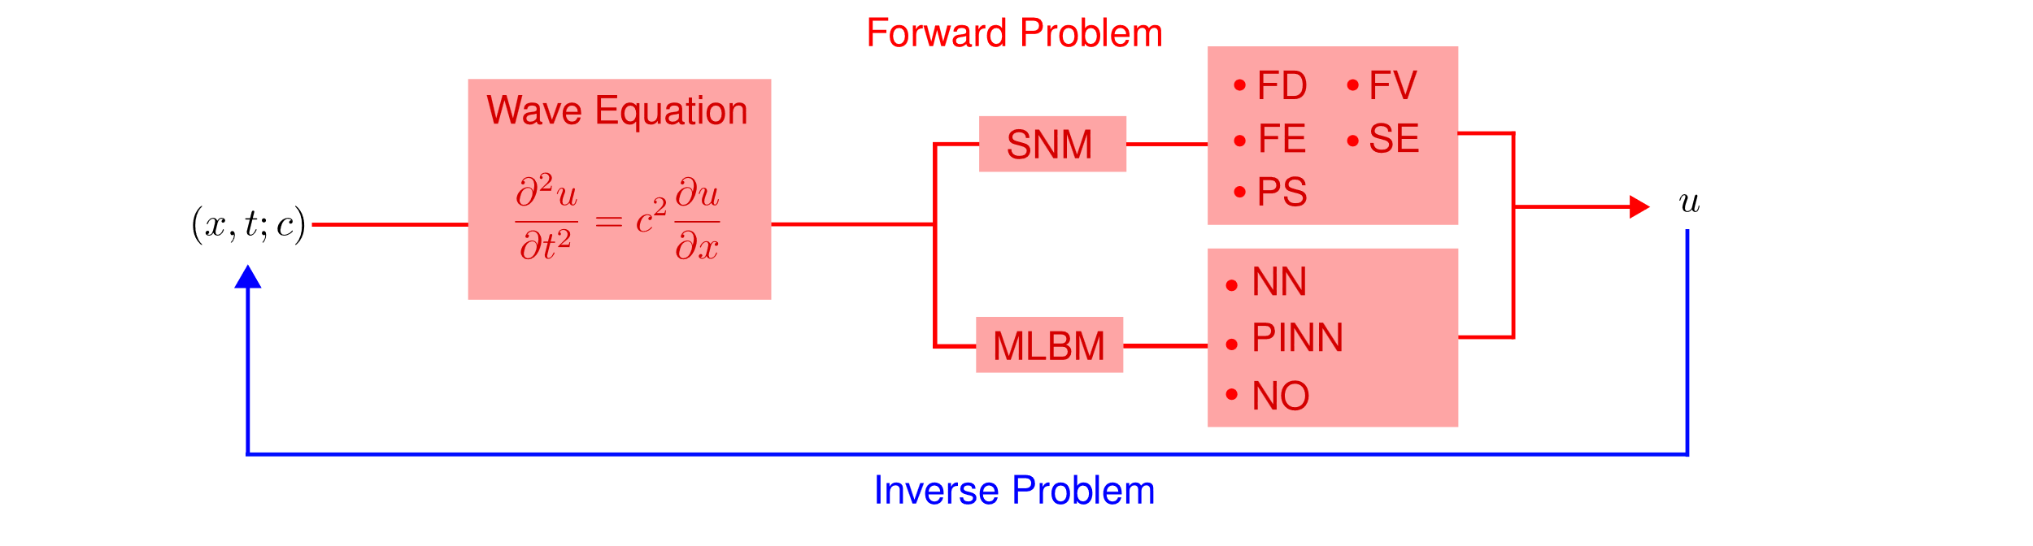
Modeling of Mechanical Wave Propagation
The process of determining the causes of a set of observations is known as the inverse problem (Tarantola, 2005), aiming to infer, for example, the properties of a medium based on its reaction to mechanical wave propagation.

Slide 4
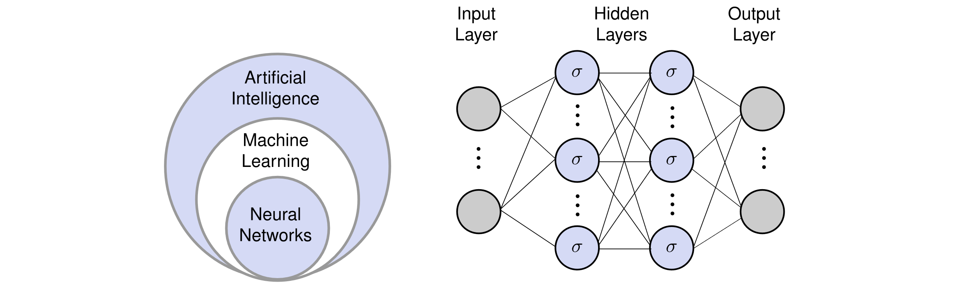
Machine learning Methods to solve Diferential Equations

Slide 5
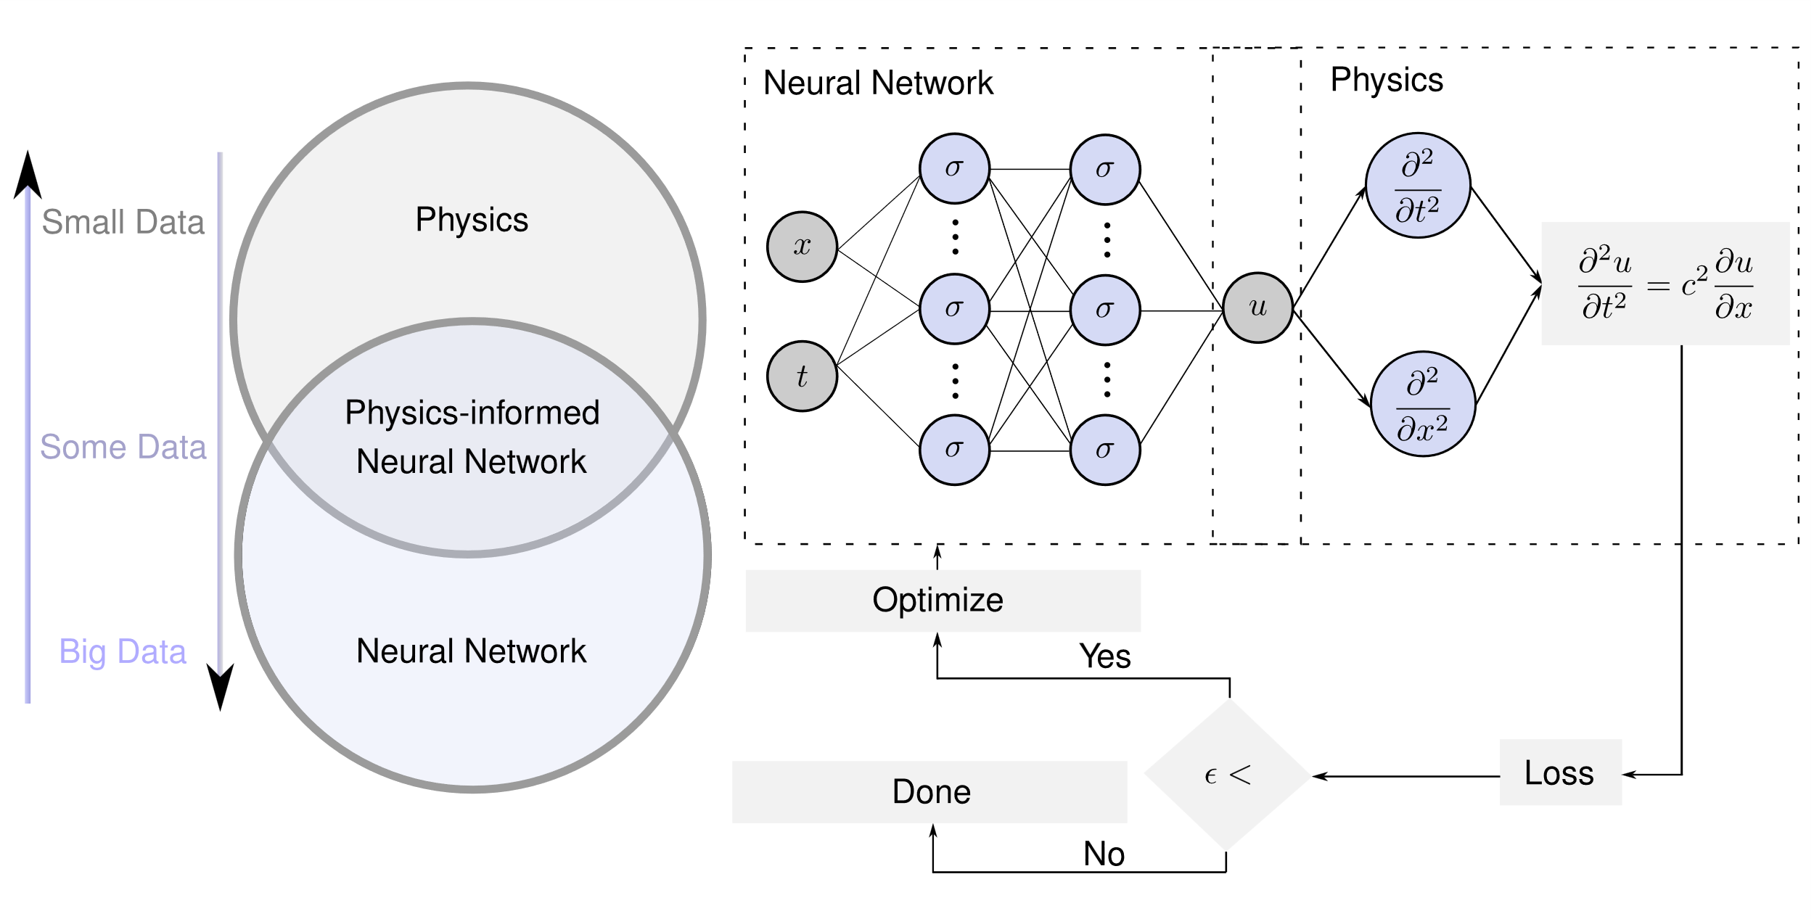
Physics-informed neural networks

Slide 6
Raissi et al. (2019)
Continuous time identification
https://github.com/oscar-rincon/ReScience-PINNs

Slide 7
Raissi et al. (2019)
Discrete time inference
https://github.com/oscar-rincon/ReScience-PINNs

Slide 8
Raissi et al. (2019)
Discrete time inference
https://github.com/oscar-rincon/ReScience-PINNs

Slide 9
Raissi et al. (2019)
Continuous time inference
https://github.com/oscar-rincon/ReScience-PINNs

Slide 10
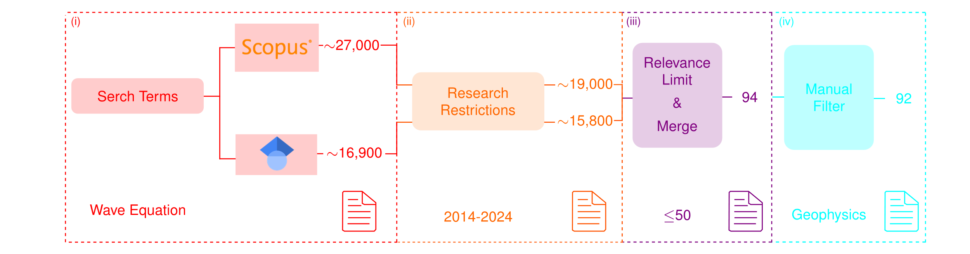
Revisión Sistemática de aplicaciones

Slide 11
Ventajas / Desvantajas

